Slide 1
A new financial Cooperative system based Permissioned Blockchain

Slide 2
What is blockchain and how does it work
A Blockchain is a type of diary or spreadsheet containing information about transactions. Each transaction generates a hash. ... Each block refers to the previous block and together make the Blockchain. A Blockchain is effective as it is spread over many computers, each of which have a copy of the Blockchain. There three existing kind of blockchain:
Permissionless Blockchain/Public Blockchain
Permissioned Blockchain/Private Blockchain
Hybrid Blockchain
Consortium Blockchain
Notes:
Permissioned Blockchain is the focus of our study

Slide 3
Permissioned Blockchain
Permissioned blockchains are blockchain networks that require access to be part of. There are different type of permissioned blockchain. Depending on the trust among participant on the network and depending on the data shared among participant, permissioned blockchain is more effective for participant with no trust one another and with the desire to share private Data.

Slide 4
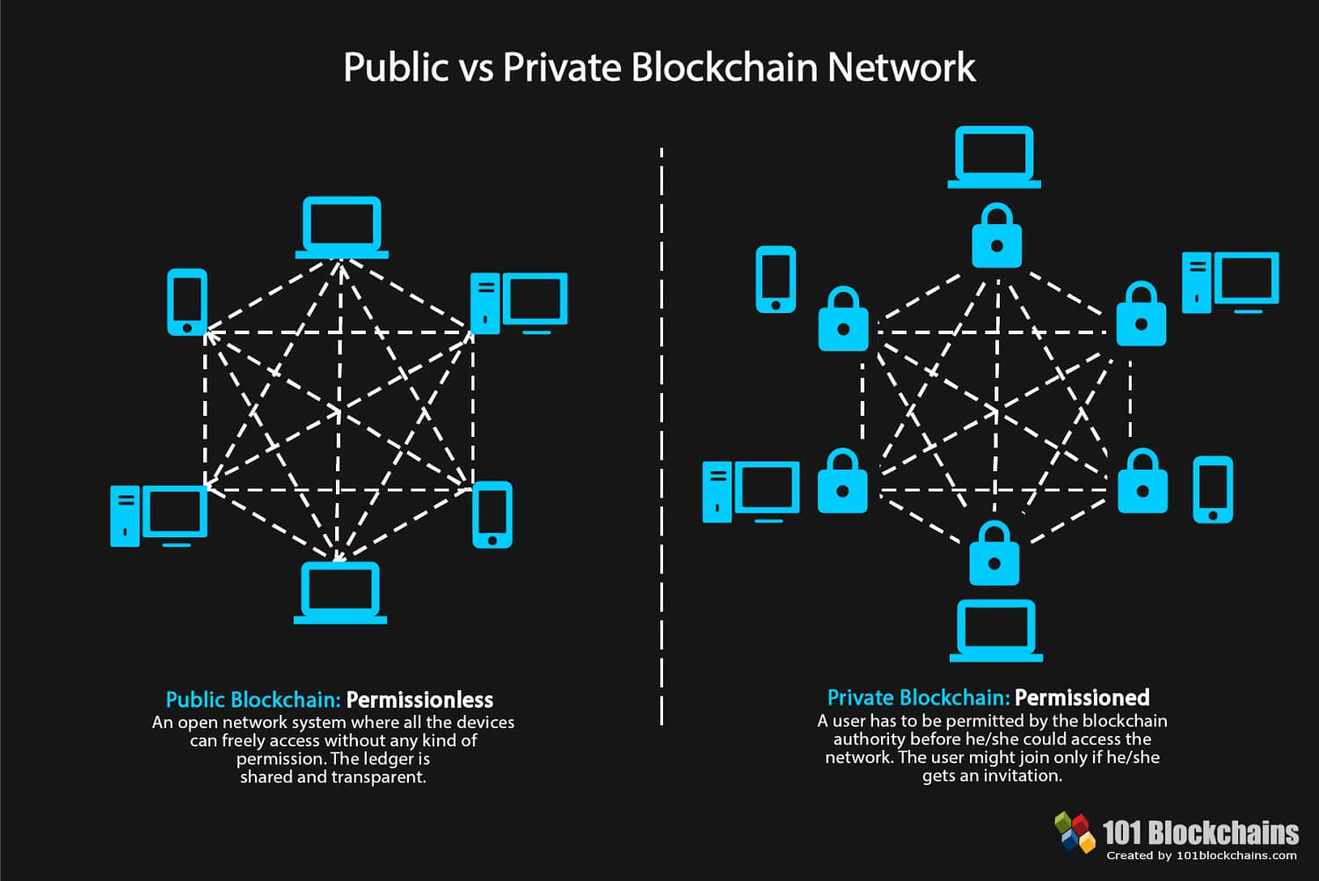
Illustration of a permissioned Blockchain vs Permissionless Blockchain

Slide 5
What is Hyperledger
Hyperledger model is developed by Linux foundation to allow organizations to build and run industry specific blockchain applications for their business. There are more than 180 members in Hyperledger that covers representatives from multiple industries including finance, insurance, healthcare, supply chain, manufacturing, etc. It has five different frameworks: Fabric, Iroha, Sawtooth, Burrow and Indy. Fabric is the first framework by Hyperledger and it is the most mature among the other platforms.

Slide 6
Advantage of using Hyperledger Fabric
Hyperledger Fabric is the most used hyperledger framework for enterprise application. Hyperledger Fabric offers:
Highly flexible architecture
Transaction Speed Is High In Hyperledger Fabric
Hyperledger Fabric Allows Private Channels
Backed By Tech Giants
Smart Contracts

Slide 7
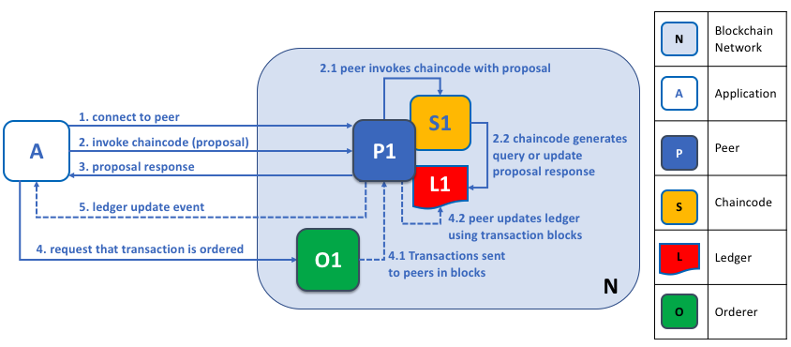
Our Hyperledger Fabric Design
Notes:
Our Fabric environment is composed of: One peer, one ordorer, one ledger and chaincode per peer and a client application.

Slide 8
Client Side
The Client side of the application is design using:
Bootstrap-vue
Vuejs
Html5
Css3
Inside the source directory, we have:
Components
Stores Directory
Routers Directory
Services Directory
The main entry file main.js

Slide 9
Server Side
We use Expressjs and Fabric sdk to implement the server side
Express is a module framework for Node that you can use for applications that are based on server/s that will "listen" for any input/connection requests from clients.
Fabric Sdk help connect to the fabric network environment. The fabric sdk connect the server to the gateway of the peer connect to the network:
We connect to the Fabric network
We register the identity of the client
We invoke functions to the peer
We receiver the invoke response

Slide 10
What the user can do through the application?
The Application can be used to:
Create a new user profile by entering his member Id, choosing his group or creating a new one, and entering his first and last Name.
They can save asst into their respective group’s account, send money from one another and request and settle a loan from or to an existing group account.
They can see all transaction or activities recorded in the ledger through the smart contract.

Slide 11
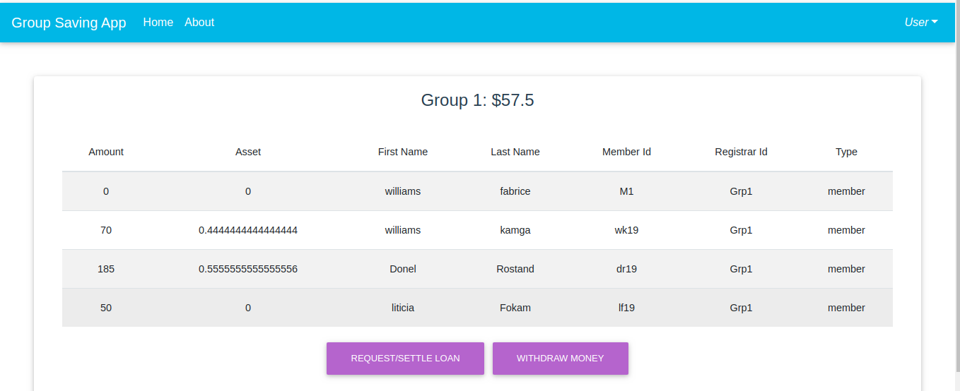
Member
Every member has a percentage on the amount save inside the group’s account:

Slide 12
Demo

Slide 13
What’s Next

